Slide 1

Conversational Samoan
AFUAGA O LE GAGANA SAMOA
Existing beliefs ~Origin/s of the language
1
Compiled by : Tamari Mulitalo -Cheung

Slide 2
Origins /O FEA NA AFUA MAI AI LE GAGANA SAMOA?
Traditional beliefs
TALITONUGA A SAMOA MAI ANAMUA??
ISI TALITONUGA???
ETC???
TALITONUGA THOR HAYERDAHL?
BIBLE/
TALITONUGA A LE TUSI PA’IA??
LINGUISTS
TALITONUGA AU LIGUISI??
PLANTS
LA’AU MA MEA TOTŌ

Slide 3
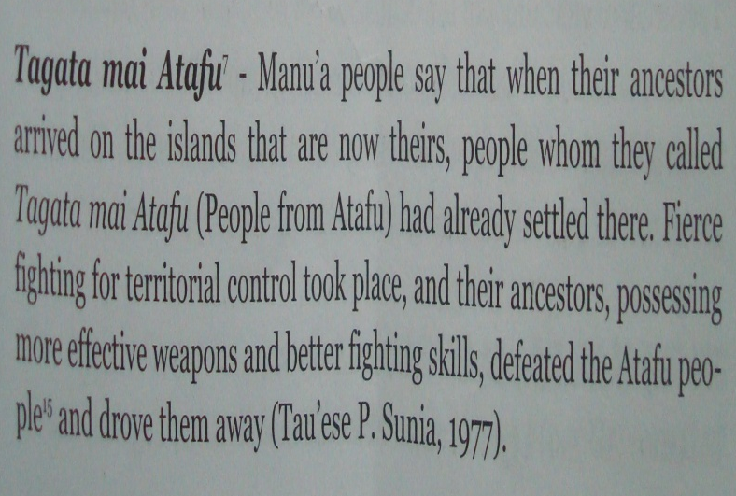
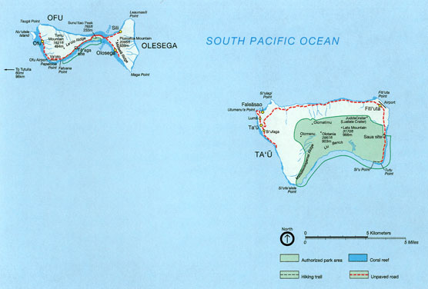
TRADITIONAL/TALITONUGA A SAMOA MAI ANAMUA??
Tapuaiga i le la e tutusa ai ma Aikupito –
Fai mai tala o le vavau sa fai aso tagata i le la :
Alagaupu :”E tafafao taliga o tufuga uli”
Story of Creation/“Solo O le Va” mai Manu’a
Manu’a as the first island: “O fea le nu’u na lua’i tupu?O Manu’a tele …”
“INA FETALAIA IA TU’UTITINO/spoke and the first human became”
Story of creation by Tagaloa sa tapua’i i ai Samoa …
Source: MARipine.
Tapuaiga i le la e tutusa ai ma Aikupito –
Fai mai tala o le vavau sa fai aso tagata i le la :
Alagaupu :”E tafafao taliga o tufuga uli”

Slide 4
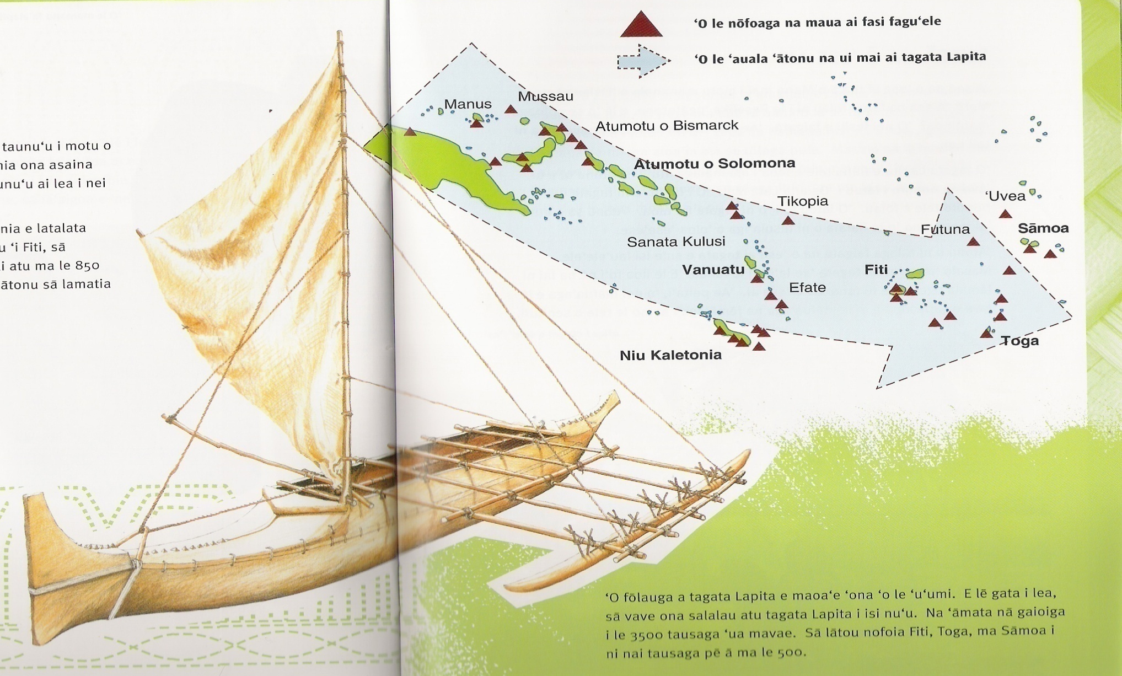
Lapita Pottery/Fagu ‘ele –Lapita –Niu Kaletonia /new caledonia

Slide 5
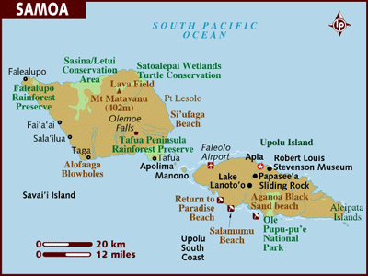
Archaeologists cont’d
Lapita in Mulifanua -Upolu
Mulifanua

Slide 6
Archaeologists cont’d
In 2007, evidence was released by the University of Auckland showing that a specific mutation in chickens native to Samoa and Tonga was seen in chicken bones found in Chile and dated to about AD 1400. This provides very strong evidence that there was trade between Polynesia and South America, though the researchers suspect that the trade originated from Polynesia, not South America.^{[5]}
http://en.wikipedia.org/wiki/Kon-Tiki
Tools, stone adzes from Tutuila in the Pacific. Tataga Matau etc
Dr.Addison SSI/ASCC
Lapita vs. Samoan tattoo patterns – Reggie Meredith Artist/ASCC

Slide 7
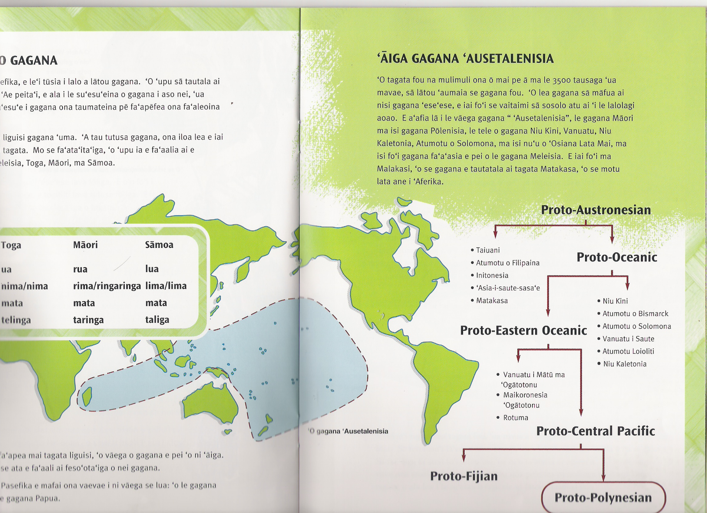
Linguists/ Talitonuga a le au liguisi

Slide 8
Plants/ Talitonuga :la’au & mea totō –mai Melei-Asia
In his paper on “The Food Plants of the Polynesians” Mr. Cheese man says: “So far as botanical inquiry has been made into the origin of the common food plants of Polynesia, it certainly seems to point to the belief that most of them are introductions from abroad, coming in the majority of cases from the direction of the Malay Archipelago or eastern tropical Asia…. /Quoting from Candolle's Origin of Cultivated Plants, Rutland says of breadfruit. “Its original habitat was the Malay Archipelago, where it was brought into cultivation at so remote a period that the cultivated varieties ceased to bear seed, and are propagated by suckers. As eastward of the Fijis only the cultivated or seedless varieties are found, it was evidently introduced into and spread through Polynesia by man.”
In his paper on the history of the Pacific Rutland also shows that “Nine species of plants foreign to the region were found in cultivation amongst the Maori of eastern Polynesia and New Zealand by early European voyages, besides the coconut, the true habitat of which has not been satisfactorily determined. Of these nine species, all but one, the kumara, belong to the Asiatic flora, and must have found their way into Polynesia from the west. The eight Asiatic species … belong, probably, to the Malay Islands.” source :http://www.nzetc.org/tm/scholarly/tei-BesPoly-t1-body-d1-d16.html

Slide 9
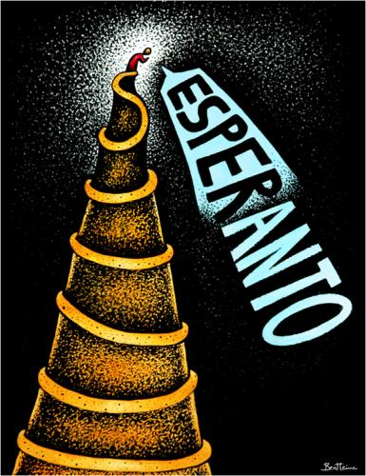
Bible/Tusi Pa’ia -Kenese
Fai e le Atua le lagi ma le lalolagi
Tu’u i ai le tagata ma manava i ai le manava ola –lē o manino mai le tuuina i totonu o le gagana
Olo i Papelu –fa’aeseese ai gagana
  ESPERANTO –taumafaiga e toe foi le lalolagi I le gagana e tasi i tua atu o le olo i Papelu

Slide 10
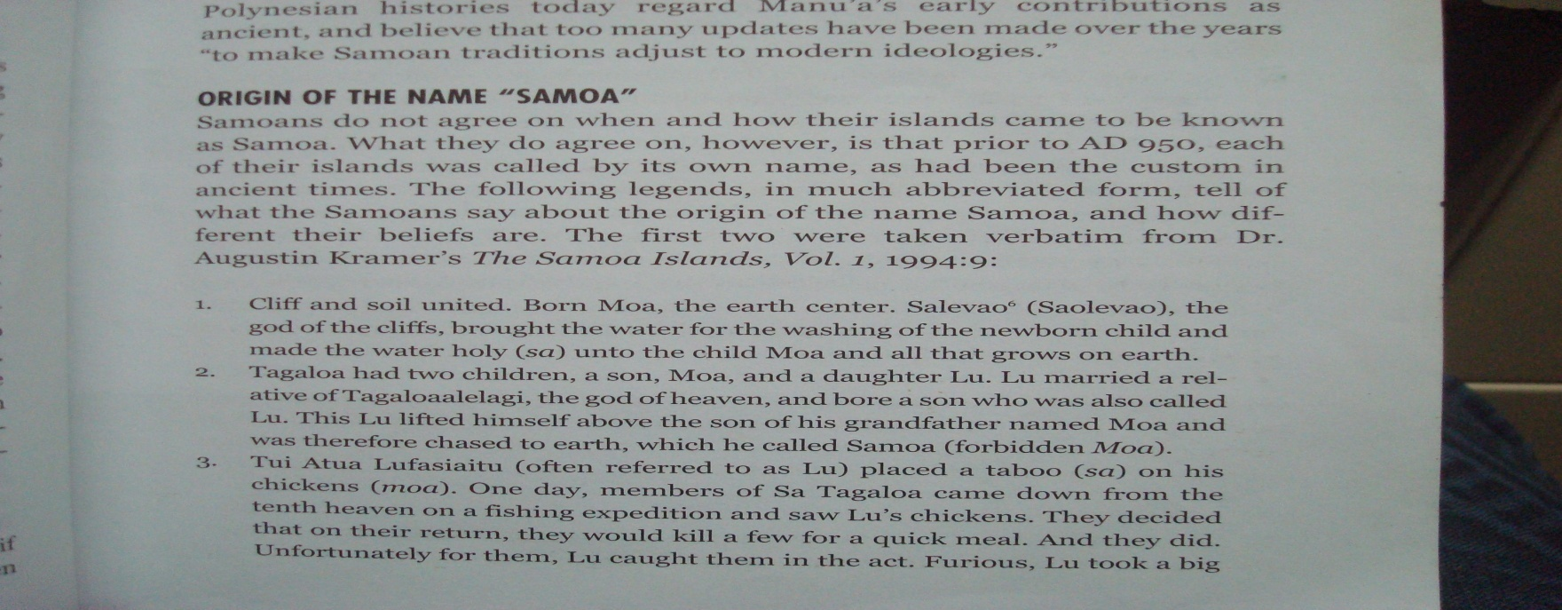
Anthropologists
Anthropologist Robert C. Suggs included a chapter on "The Kon-Tiki Myth" in his book on Polynesia. He concludes:
  "The Kon-Tiki theory is about as plausible as the tales of Atlantis, Mu, and "Children of the Sun." Like most such theories it makes exciting light reading, but as an example of scientific method it fares quite poorly.^{[3]} The Kon-Tiki expedition attracted many comments similar to the above. Donald P. Ryan presents a retrospective overview about Heyerdahl's theories and their reception.^{[4]}

Slide 11
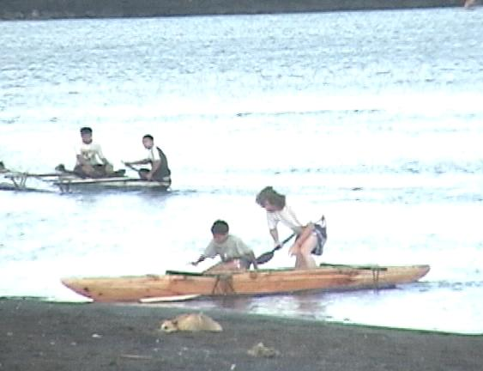
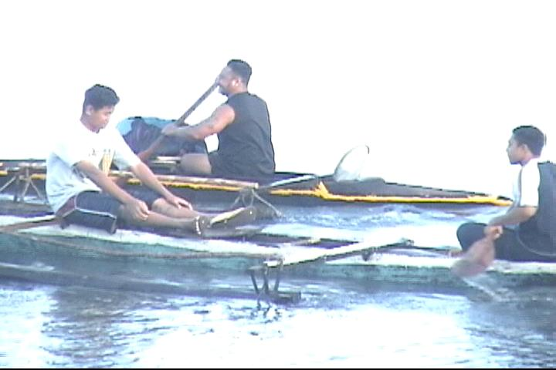
21
MANUIA LOU ALOFAIVA –O OUTOU MĀMĀ NA!
May you be blessed in your endeavours

